Slide 1

Welcome to
JAVA PROBLEMS
by
MD : RAHATUL ISLAM
B.Sc. Engineering Dept. of Ice at PUST.
Gmail ID : rahatul.ice.09.pust@gmail.com
Mobile No : 01790224950

Slide 2
Compiling and Running Programs
Install the latest release of the Java SE platform, if you haven't already done so (JDK).
Setup Environment variable for JDK.
Install IDE such as NetBeans, Eclipse
Create a program that uses Swing components.
Compile the program.
Run the program.
Note: File name and class name must be the same

Slide 3
Required Software
Download
JDK, https://www.oracle.com/java/technologies/downloads/#jdk21-windows
NetBeans, https://netbeans.apache.org/front/main/download/nb122/nb122/
Or, Eclipse, https://www.eclipse.org/downloads/download.php?file=/oomph/epp/2023-12/R/eclipse-inst-jre-win64.exe
For JDBC
UCanAccess, Download-> https://sourceforge.net/projects/ucanaccess/
WindowBuilder, Download-> https://download.eclipse.org/windowbuilder/updates/release/latest/
For Database Connection: https://www.youtube.com/watch?v=MbDoMexPcYc

Slide 4
Overview
1. Java basic
2. Java Variables
3. Java Data Types
4. Java Type Casting
5. Java Operator.
6. Java Strings
7. Java Math.
8. Java Switch
9. Java Loop
10. Java Break/ Continue
11. Java Arrays
12. Java Methods
13. Method Overloading, Overwriting
14. Java Recursion
15. Java OOP (8- Features)
16. Encapsulation
17. Inheritance (5-Types)
18. Polymorphism (2-Types)
19. Abstraction
20. Interface
21. User Input
22. Java Date
23. Array List
24. Linked List
25. Hash Map
26. Hash Set
27. Java Iterator
28. Wrapper Classes
29. Java RegEx
30. Java Files
31. Number Formatting
32. Final Keyword
33. Final Method
34. Number Conversion
35. Return Method
36. This Keyword
37. Type Casting

Slide 5
JAVA Programs
Problem - 1

Slide 6
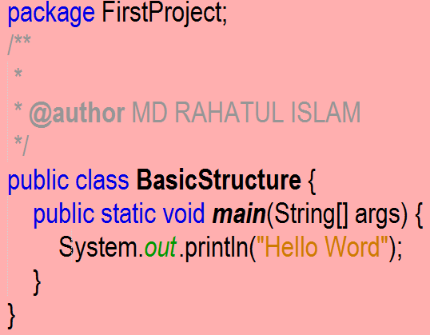
Tropic Basic Structure
What is Basic Structure of JAVA programs ?
Example :-

Slide 7
Tropic Value Initialization
Integer Type value Initialization :› EX : int num1=234;
Character Type value Initialization :› EX :- char num2=‘R’;
Float Type value Initialization :› EX : float num3=2.34f;
Double Type value Initialization :› EX : double num4=2.34;
String Type value Initialization :› EX : String num5=“Rahatul Islam”;
Or char[] num5={‘R’, ‘a’, ‘h’, ‘a’, ‘t’, ‘u’, ‘l’, ‘ ’, ‘i’, ‘s’, ‘l’, ‘a’, ‘m’};

Slide 8
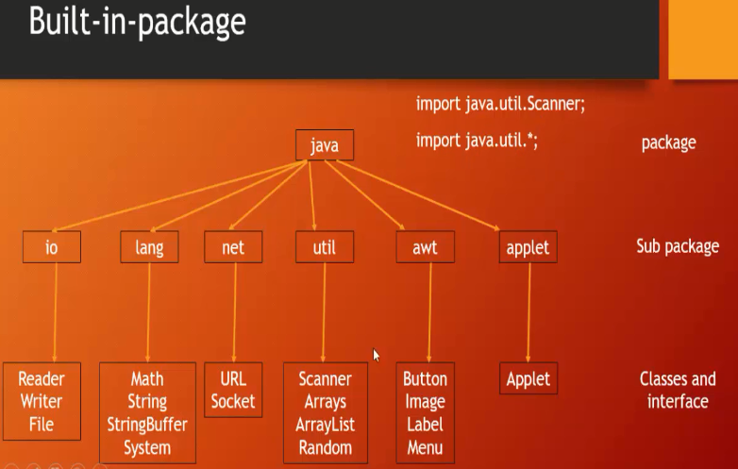
Tropic Get Input into User
package FirstProject;
import java.util.Scanner;
public class GetInputIntoUser {
public static void main(String[] args) {
Scanner Rahat = new Scanner(System.in);
System.out.printf("Enter any String : ");
String num = Rahat.nextLine();
System.out.printf("Enter any Interger number : ");
int num1= Rahat.nextInt();
System.out.printf("Enter any Character Case : ");
char num2 = Rahat.next().charAt(0);
System.out.printf("Enter any float number : ");
float num4 = Rahat.nextFloat();
System.out.printf("Enter any double number : ");
double num5 = Rahat.nextDouble();
}
}

Slide 9
Tropic Format Specifier
What is Format Specifier of JAVA programs?
There are several type of Format Specifier such as :-
1.Type of Integer EX : Printf(“%d\n”,rahat);
2.Type of Character EX : Printf(%c\n”,rahat);
3.Type of float EX : Printf(%f\n”,rahat);
4.Type of double EX : Printf(%f\n”,rahat);
5.Type of octat EX : Printf(%o\n”,rahat);

Slide 10
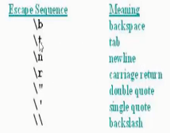
Tropic Escape Sequence
What is Escape Sequence ?
Answer -> It is a special character followed by backslash.
Example :-

Slide 11
JAVA Programs
Problem - 2

Slide 12
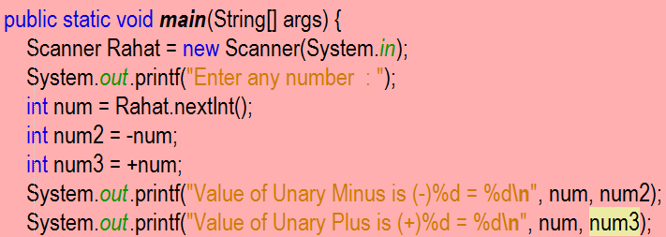
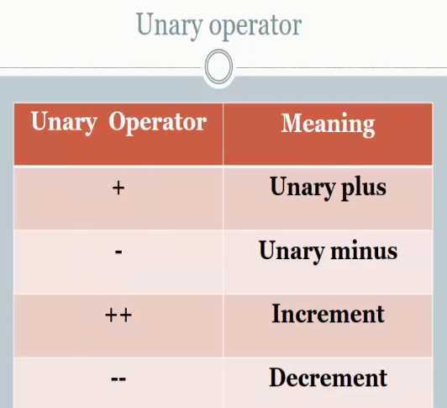
Tropic Unary Operator
Example :-
Unary Minus
Unary Plus

Slide 13
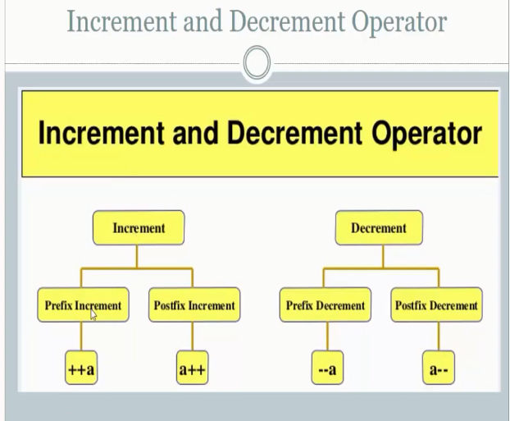
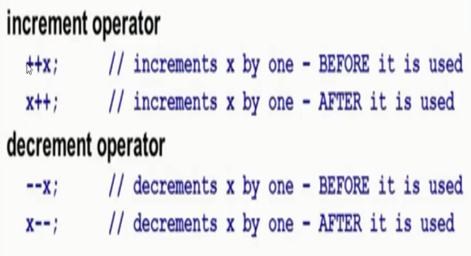
Tropic Increment Decrement
Example :-

Slide 14
JAVA Programs
Problem - 3

Slide 15
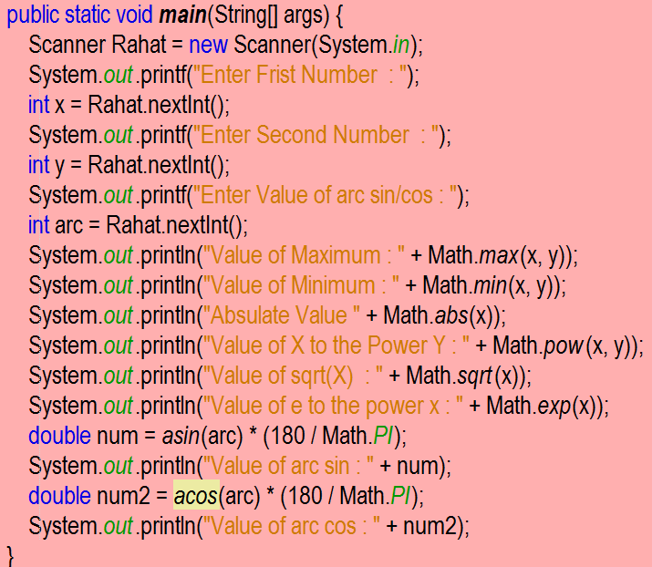
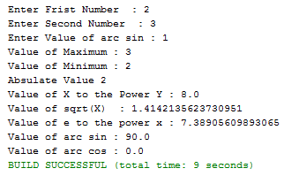
Tropic Method of Math Class
<Example >
<Output >
Math.max(x,y);
Math.min(x,y);
Math.abs(x);
Math.pow(x,y);
Math.exp(x);
Math.PI;
Math.asin();
Math.acos();
Math.sqrt();

Slide 16
JAVA Programs
Problem - 4

Slide 17
Tropic Loop
There are several types of Loop in java Programs such as :-
for Loop.
while loop.
do while loop.
for each loop.
Iterator loop
Recursion

Slide 18
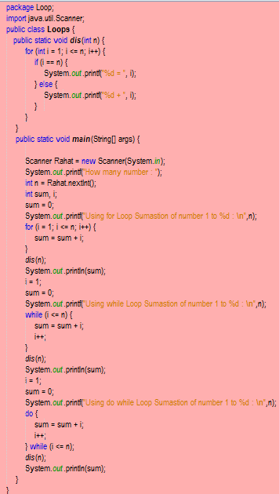
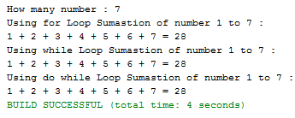
Tropics for, while, do while Loop
Output
<Example >
For loop
While loop
do while loop
Note . Details : Tropic Method/OOP.

Slide 19
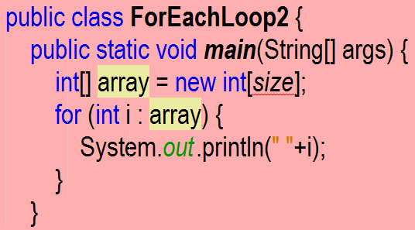
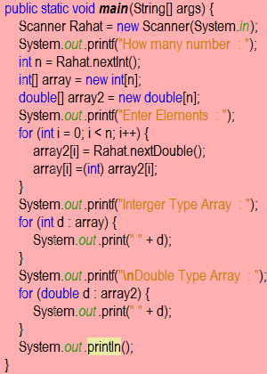
Tropic for each loop
<Example >
<Basic Structure>
for each loop
Note . Details : Tropic Array.

Slide 20
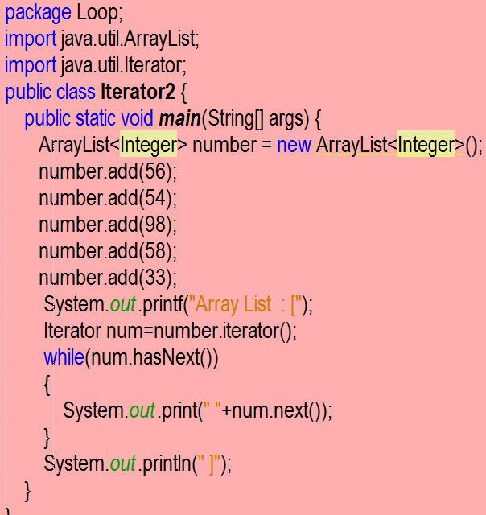
Tropic Iterator
Output
<Example >
Array List : [ 56 54 98 58 33 ]
Note . Details : Tropic Array List.
Iterator

Slide 21
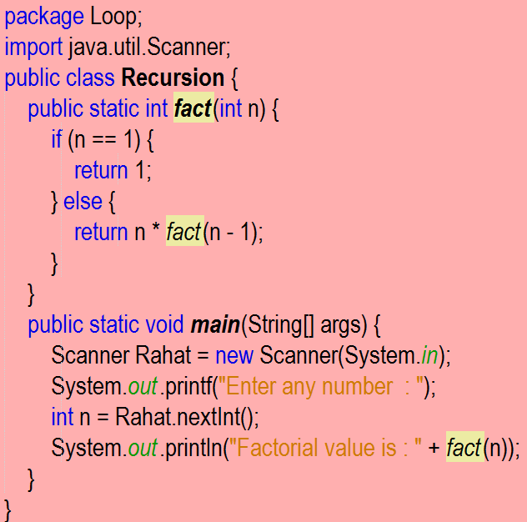
Tropic Recursion
Input
<Example >
Output
Enter any number : 5
Factorial value is : 120
Note . Details : Tropic OOP.
Recursion

Slide 22
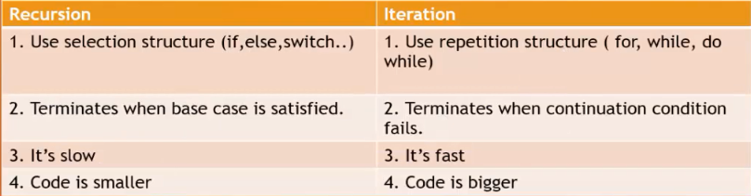
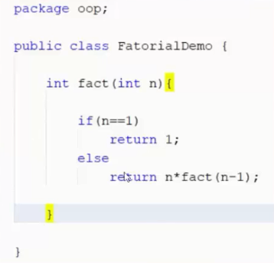
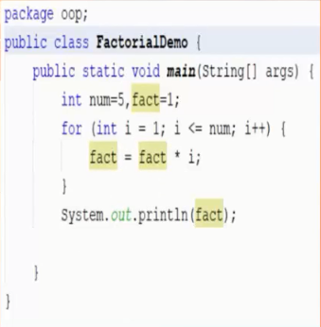
Tropic Deference between Recursion & Iterator
Recursion
Iterator
<Example >
<Example >

Slide 23
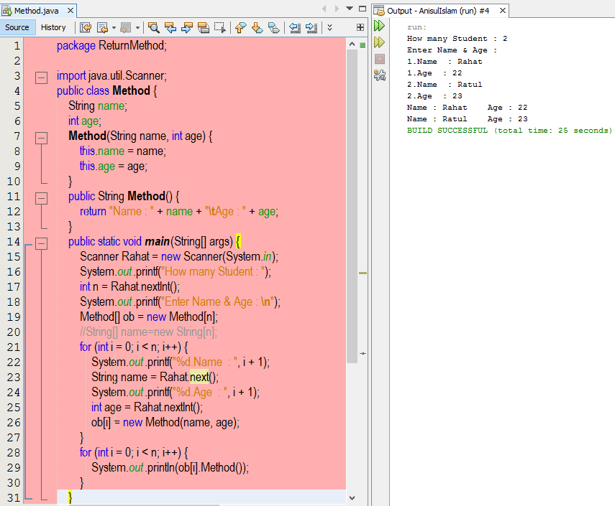
Tropic Return Method

Slide 24
JAVA Programs
Problem - 5

Slide 25
Tropic Array
What is Array ?
Answer -> An array is a collection of variables of the same type.
There are two types of Array such as :-
1.Integer Type Array.
2.Double Type Array.

Slide 26
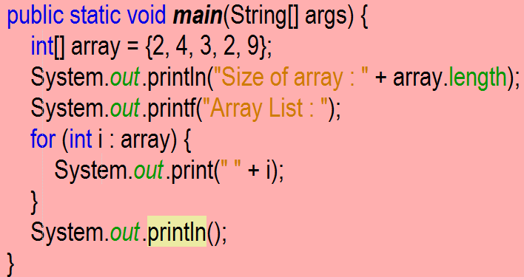
Tropic Array Initialization
Array Initialization are two methods such as :-
int[] array = {2,4,3,2,9};
Example :-

Slide 27
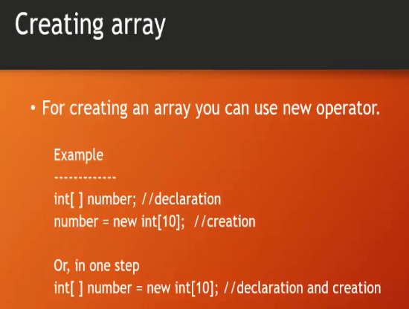
Tropic Array Initialization
<Example >
Array Initialization are two methods such as :-
2.double[] array =new double[5] Or int[] array = new int[5];

Slide 28
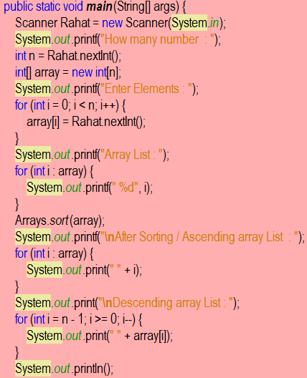
Tropic Array Sorting
Array Sorting are two types these are :-
Ascending Order -> EX – [2,4,5,6,7,8,9];
Descending Order -> EX – [9,8,7,6,5,4,2]
Example :-

Slide 29
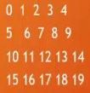
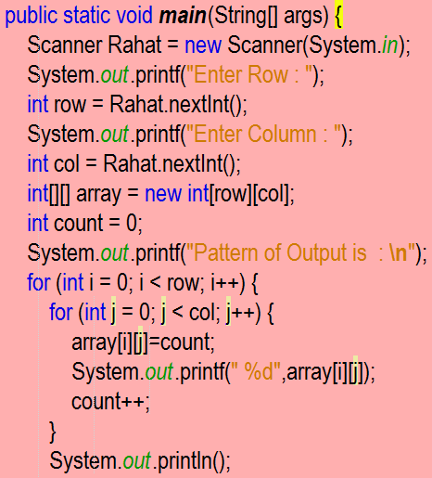
Tropic 2D Array output
< Output –1 >

Slide 30
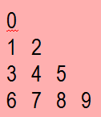
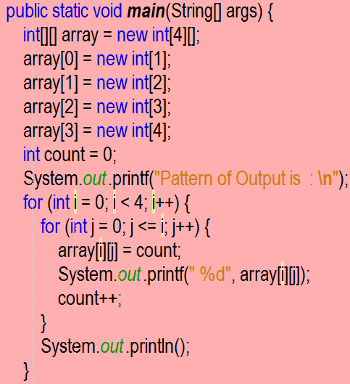
Tropic 2D Array output
< Output –2 >

Slide 31
JAVA Programs
Problem - 6

Slide 32
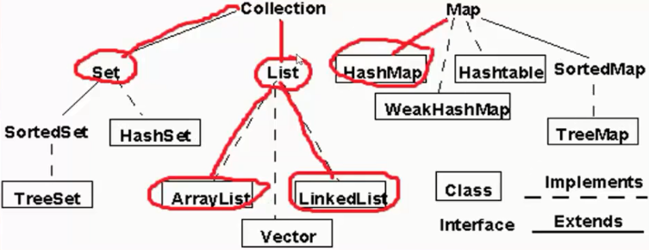
Tropic List

Slide 33
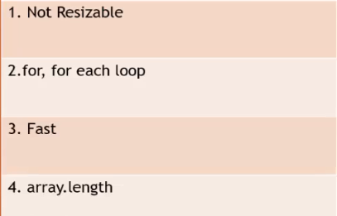
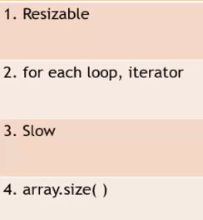
Tropic Deference between Array & Array List
Array :
Array List :

Slide 34
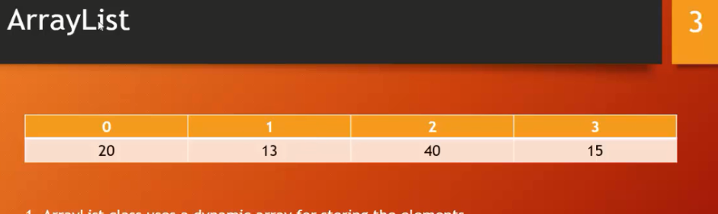
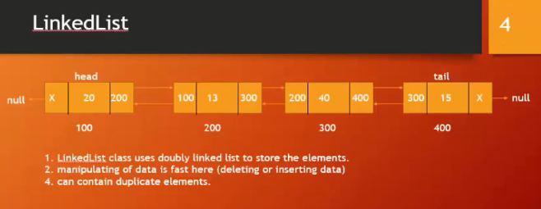
Tropic Deference between Array List & Linked List
Array List :
Linked List :
<Example >
<Example >
Array List class uses a dynamic array for sorting the elements.
Array List is better for sorting & accessing data.
Slow for manipulating data (deleting or inserting data).
Can contain duplicate elements.
Linked List class double linked list to store the elements.
Array List is not better for sorting & accessing data.
Manipulating of data is fast here (deleting or inserting data).
Can contain duplicate elements.
Index
Address

Slide 35
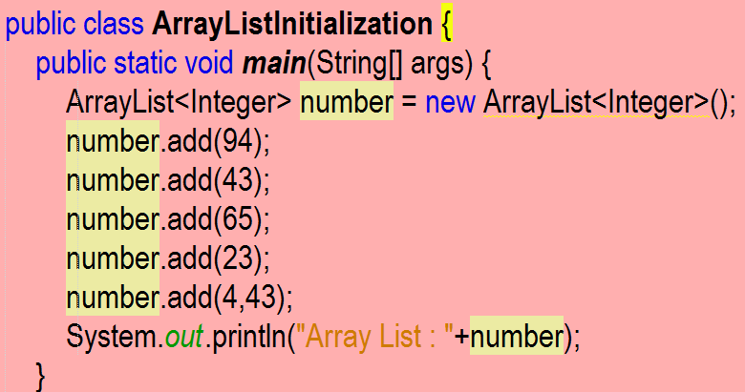
Tropic Array List Initialization
Array List Initialization & Add Elements :
1. Array List Initialization :
ArrayList[Integer] number = new ArrayList<Integer>(); or, ArrayList[Double] number = new ArrayList<Double>();
2. Add Elements in the Array List :
number.add(element1);
number.add(element2);
number.add(element3);
number.add(element4);
Or,
number.add(index, element5);
Example :-
Output : Array List : [94, 43, 65, 23, 43]

Slide 36
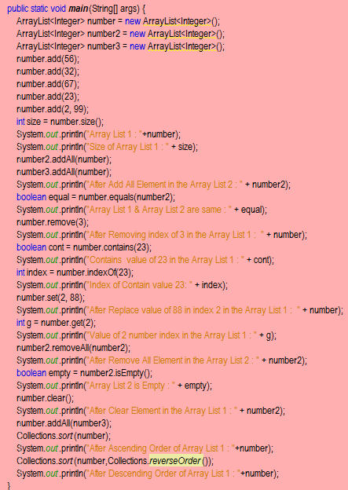
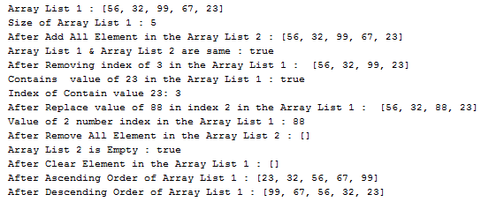
Tropic Method of Array List
<Output >
<Example >
size();
add();
remove();
removeAll();
clear();
isEmpty();
contains();
indexOf();
set();
get();
equals();
addAll();
Collections.sort(ArrayList Name);
Collections.sort(ArrayList Name,Collections.reverseOrder());

Slide 37
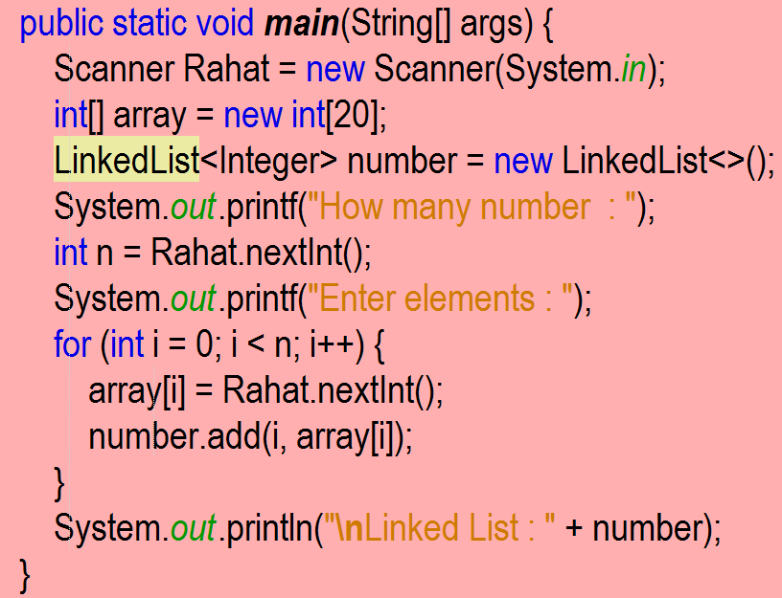
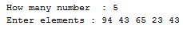
Tropic Linked List Initialization
Linked List Initialization & Add Elements :
1. Linked List Initialization :
LinkedList[Integer] number = new LinkedList<Integer>(); or, LinkedList[Double] number = new LinkedList<Double>();
2. Add Elements in the LinkedList :
number.add(element1);
number.add(element2);
number.add(element3);
number.add(element4);
Or,
number.add(index, element5);
Example :-
Input :
Output : Linked List : [94, 43, 65, 23, 43]

Slide 38
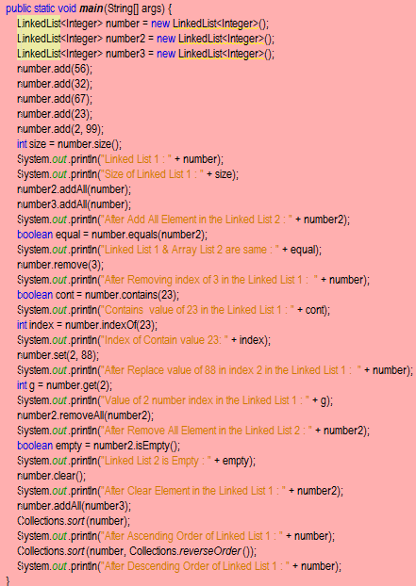
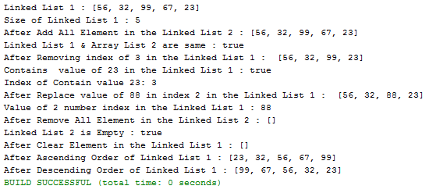
Tropic Method of Linked List
<Example >
<Output >
size();
add();
remove();
removeAll();
clear();
isEmpty();
contains();
indexOf();
set();
get();
equals();
addAll();
Collections.sort(LinkedList Name);
Collections.sort(LinkedList Name,Collections.reverseOrder());

Slide 39
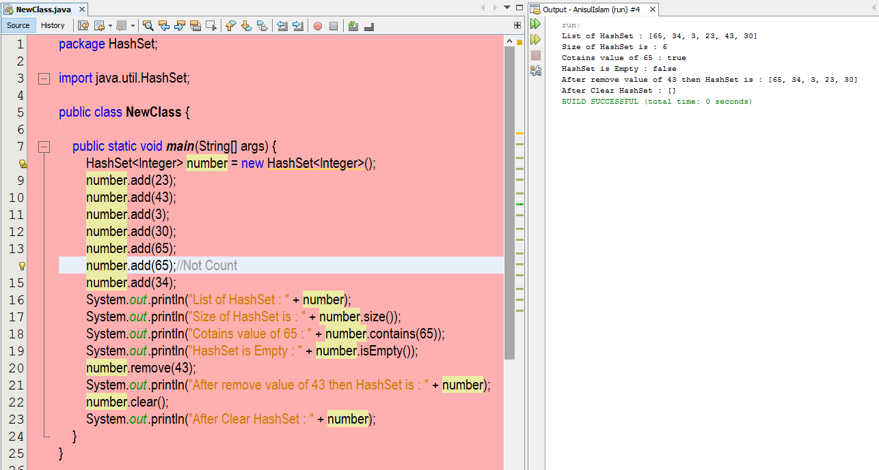
Tropic HashSet
Example
HashSet Related to LinkedList.
HashSet don’t count same value.
(It Sorting by Alphabet)
Not Count

Slide 40
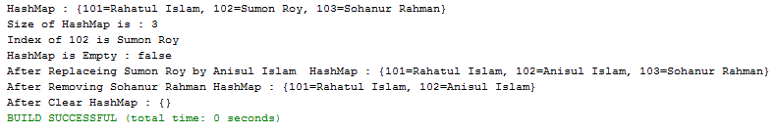
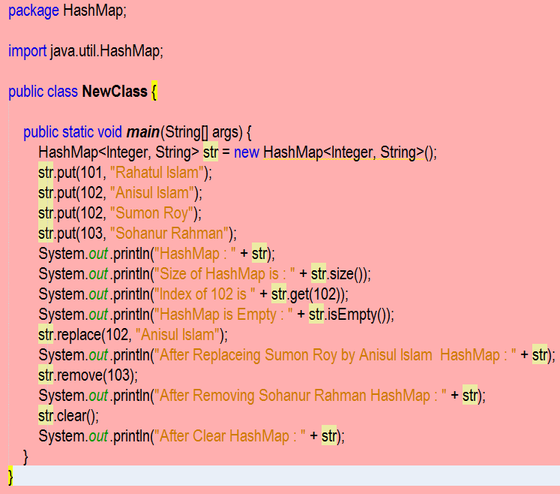
Tropic HashMap
Example
Output
HashMap don’t count same value.
Same Index One Value Count

Slide 41
JAVA Programs
Problem - 7

Slide 42
Tropic String
String create by three method / class such as :-
String class.
String Buffer class.
String Builder class.

Slide 43
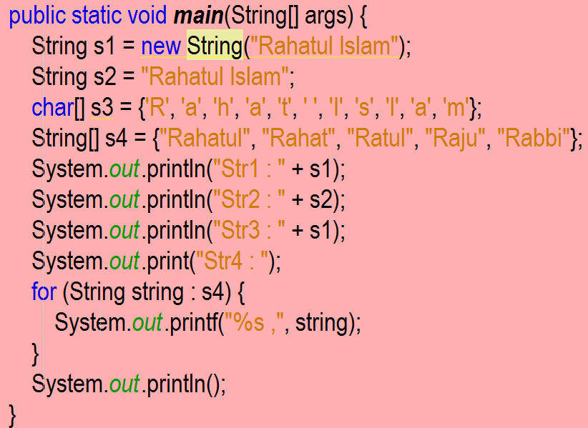
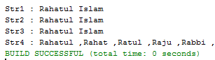
Tropic String Class Initialization
<Example >
<Output >
Several types of String class create & Initialization :
String str1 = new String("Rahatul Islam");
String str2 = "Rahatul Islam";
char[] str3 = {'R', 'a', 'h', 'a', 't',' ','I','s','l','a','m'};
String[] str4 = {"Rahatul", "Rahat", "Ratul", "Raju", "Rabbi"};

Slide 44
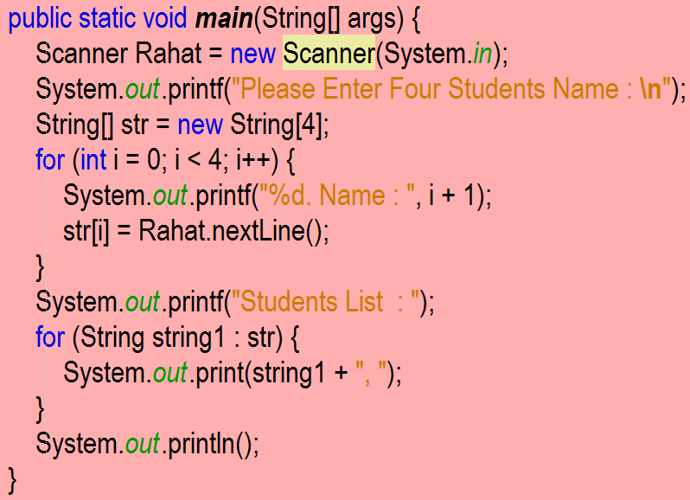
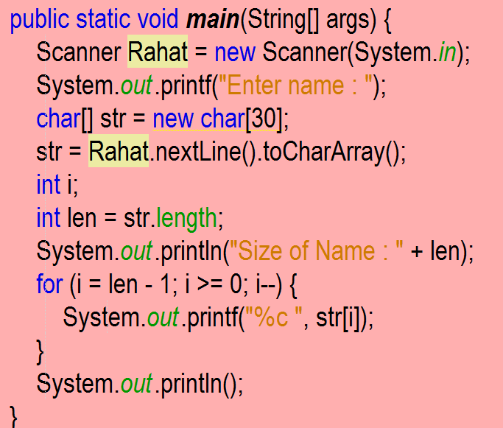
Tropic Get Input into User For String
Get input into User for String are two method such as :-
Example-1
Example-2
Note . Problem Search Google.

Slide 45
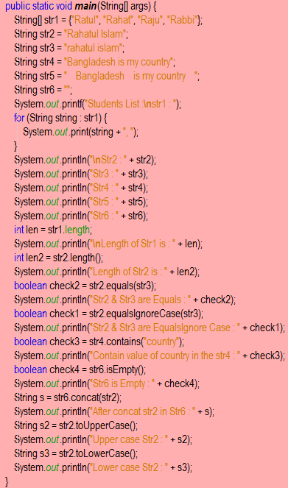
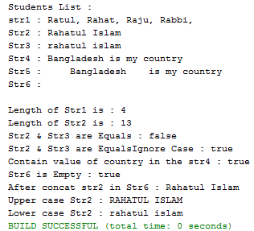
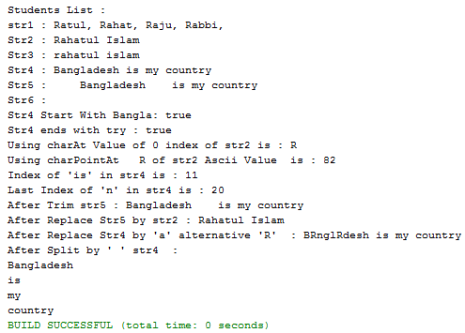
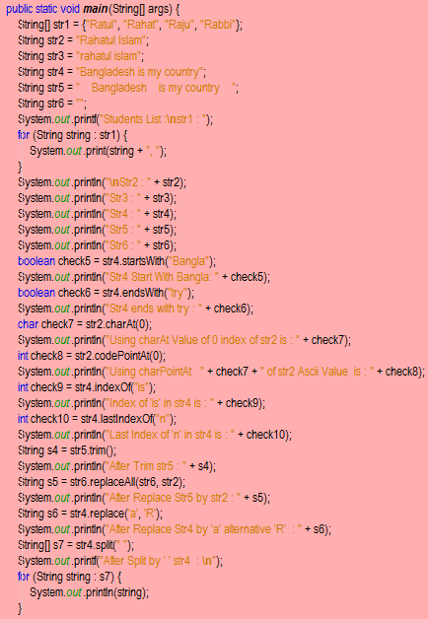
Tropic Method of String Class
<Output - 2>
<Example - 1>
<Output - 1>
<Example - 2>
length;
length()
equals();
equalsIgnoreCase();
contains();
isEmpty();
Concat();
toUpperCase();
toLowerCase();
startsWith();
endsWith();
charAt();
charPointAt();
indexOf();
lastIndexOf();
trim();
replace();
replaceAll();
split();

Slide 46
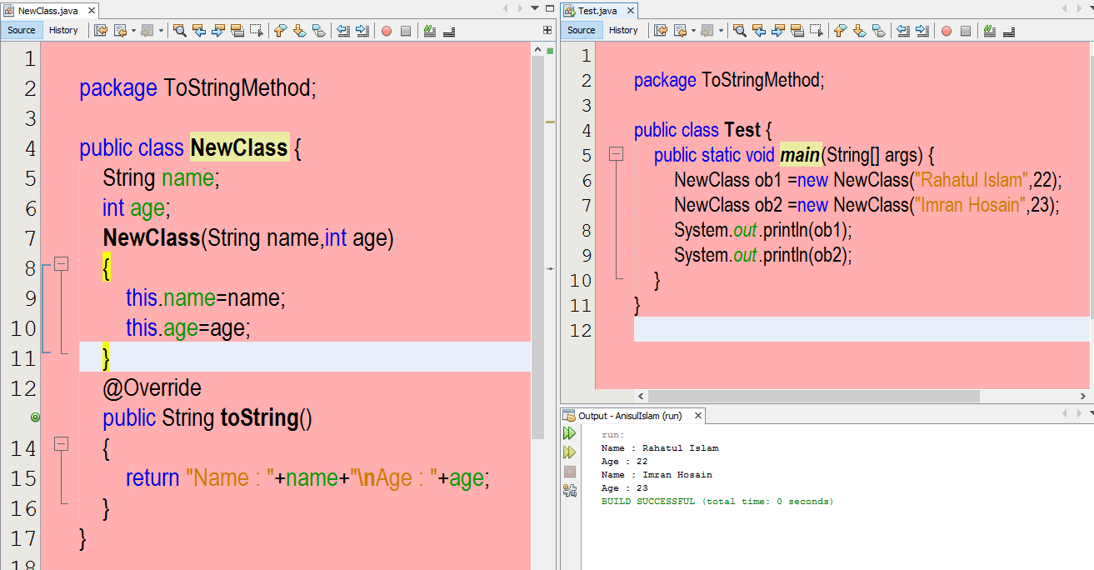
Tropic toString Method
Example

Slide 47




Tropic Method of String Buffer & Builder Class
<Output - 1>
<Example - 1>
<Example - 2>
<Output - 2>
SetLength();
append();
delete();
reverse();
replace();

Slide 48



Tropic Wrapper Class
Wrapper classes are used to convert primitive into object and object into primitive data type .
This is use two method such as :-
Auto boxing -> Converting primitive data type to object.
Unboxing -> Converting object to primitive data type.
Auto boxing
Unboxing
Example-1
Example-2

Slide 49


Tropic Section-2
Primitive to String data type
String to Primitive data type

Slide 50




Tropic Convert Number
Output-1
Output-2
Decimal into Binary, Octal, Hex
Binary, Octal, Hex into Decimal

Slide 51


Tropic Date & Time
Output-1
Output-2
Date
Time
Today Date is : 16/06/2020
Now, Today Time is : 12:13:14

Slide 52

Tropic Random Number
<Example>

Slide 53
JAVA Programs
Problem - 8

Slide 54

Tropic OOP

Slide 55

Tropic Class
What is Class ?
Answer -> A class is blue print or template from which individual objects are created.
Class declaration :

Slide 56
Tropic Constructor
Types of Constructor :
Constructor
Default Constructor
Parameterized Constructor

Slide 57

Tropic Deference between Constructor & Method

Slide 58
Tropic static Keyword
Static keyword used three ways such as :-
Static variable -> Static variable is not related to object. It is related to class. Using static member can’t create object but it call by the class using dot(.) operator. ex-Student count
Static method :
i) Static method can’t use non static member.
ii) “this” and “super” keyword can’t be used here.
Static block-> At First it is called then another or main function called.

Slide 59



Tropic Variable
Types of Variable :
There are three types of variable in JAVA.
Variable
Local
Class/static
instance

Slide 60

Tropic Type Conversion

Slide 61


Tropic Variable length
Example
Output
Variable length arguments is also called Varargs method.
What is Varargs ?
Answer -> A method that takes a variable number of arguments is called a varargs method.

Slide 62


Tropic Argument Pass
Call-by-value
Call-by-reference
There are two ways to pass an argument.
Call-by-value/ pass-by-value.
Call-by-reference/ pass-by-reference

Slide 63


Tropic Deference between Call-by-value & Call-by-reference
Call-by-value
Call-by-reference

Slide 64

Tropic Core concepts in OOP
There are Four core concepts in OOP.

Slide 65



Tropic Access Modifier
Example
There are Four types of access modifier in JAVA .
private.
default.
protected.
public.

Slide 66



Tropic Encapsulation
Example
Benefits of Encapsulation
Provides data hiding.
Reusability.
Code can be modified without breaking the code.
Maintainability : Hiding implementation details reduces complexity.
How to do Encapsulation ?
Declare the variables as private.
Provide public setter & getter method to modify and get the variables value.

Slide 67

Tropic instanceof Operator

Slide 68

Tropic super Keyword
Note : Details Example inheritance

Slide 69


Tropic Inheritance
Example
There are Four types inheritance in OOP language.
inheritance
Multilevel
Hierarchical
Multiple
Single

Slide 70


Tropic Single Inheritance
Basic Structure
Example

Slide 71


Tropic Multilevel Inheritance
Basic Structure
Example

Slide 72


Tropic Hierarchical Inheritance
Basic Structure
Example

Slide 73



Tropic Multiple Inheritance
Basic Structure
Example
Note : Multiple Inheritance can’t support in java.
Because :-
B,C

Slide 74


Tropic Support Multiple Inheritance
Multiple Inheritance
Example
Why interface support multiple inheritance where class don’t ?

Slide 75


Tropic Method Overriding
Example
Q.1 What is Method Overriding ?
Answer -> Declaring a method in subclass which is already present in superclass is known as Method Overriding.
Q.2 Why do we need Method Overriding ?
Code reuse.
One interface, multiple implement.
Run time polymorphism.
Q.3 What are the rules for Method Overriding ?
Q.4 Can we Override static method ?
Answer -> No, static method can’t be Overridden. Because static method is bound to class, on the other hand method is bound to object.
Q.5 Can we Override JAVA main method ?
Answer -> No, Because main is a static method.
Note. Constructor can’t be Overridden but it can be inherit.

Slide 76


Tropic Deference between Overloading & Overriding
Overloading
Overriding
Example

Slide 77


Tropic this Keyword
Example

Slide 78




Tropic final Keyword
Final variable
Example
Final Method
Final Class
Question related Final keyword
There are three types of variable in JAVA. Such as-
Final variable
Blank final variable.
Static blank final variable.
final class can’t be inherit.
final method can’t be Override but it can be inherit.
Final variable
Final Method
Blank final variable
Static blank final variable

Slide 79





Tropic Polymorphism
Types of polymorphism :
There are two types of polymorphism such as-
Compile time / static polymorphism -> EX- Method Overloading, Constructor Overloading.
Run time / dynamic polymorphism -> EX : Method Overriding
Polymorphism :
= poly + morphs (two Greek words)
= many + forms
= many forms
Answer : Polymorphism is a mechanism where a parent class reference variable can take many forms ( It can refer object from different classes.)
Compile time Polymorphism
Example Polymorphism
Example
Run time Polymorphism
Example
Dynamic Method dispatch

Slide 80





Tropic Abstraction
Example
Real life Example
Point to be Remember
Abstract Class
Q.1 What is Abstraction ?
Answer->Abstraction is the process of hiding the implementation details & showing only the functionality to the user.
Q.2 How to achieve Abstraction ?
There are two ways to achieve abstraction in JAVA such as -
Abstract class ( 0 to 100%).
Interface (Achieve 100% abstraction).
Points to be remember about abstract method.
Abstract method has no body.
It must be ends with a semicolon.
It must be in the abstract class.
It must be Overridden.
It can never be final & static.
Anonymous Class
Instantiate : MobileUser ob = new MobileUser();

Slide 81







Tropic interface
Example
interface Method
interface Variable
Point to be Remember
Properties of interface
What is interface ?
Answer -> An interface is a collection of abstract method.
Why do we need an interface ?
For fully abstraction.
It supports multiple inheritance.
interface keyword is used to declare an interface such as –
interface Animal {
…….
}

Slide 82

Tropic Deference between interface vs Abstract Class
interface
Abstract Class

Slide 83



Tropic Type Casting
Example
Up Casting
Down Casting ,It can’t support java

Slide 84



Tropic Package
Built-in-Package
User-Defined-Package

Slide 85


Tropic Anonymous Class
Anonymous Class

Slide 86

Tropic File Class

Slide 87
Tropic Process Run to Command line
To compile : javac packageName / ClassName.java
To Run : java packageName.ClassName

Slide 88




